Slide 1
8-28-2024 Chassis Changes

Slide 2
¼” total width dimension increase

Slide 3
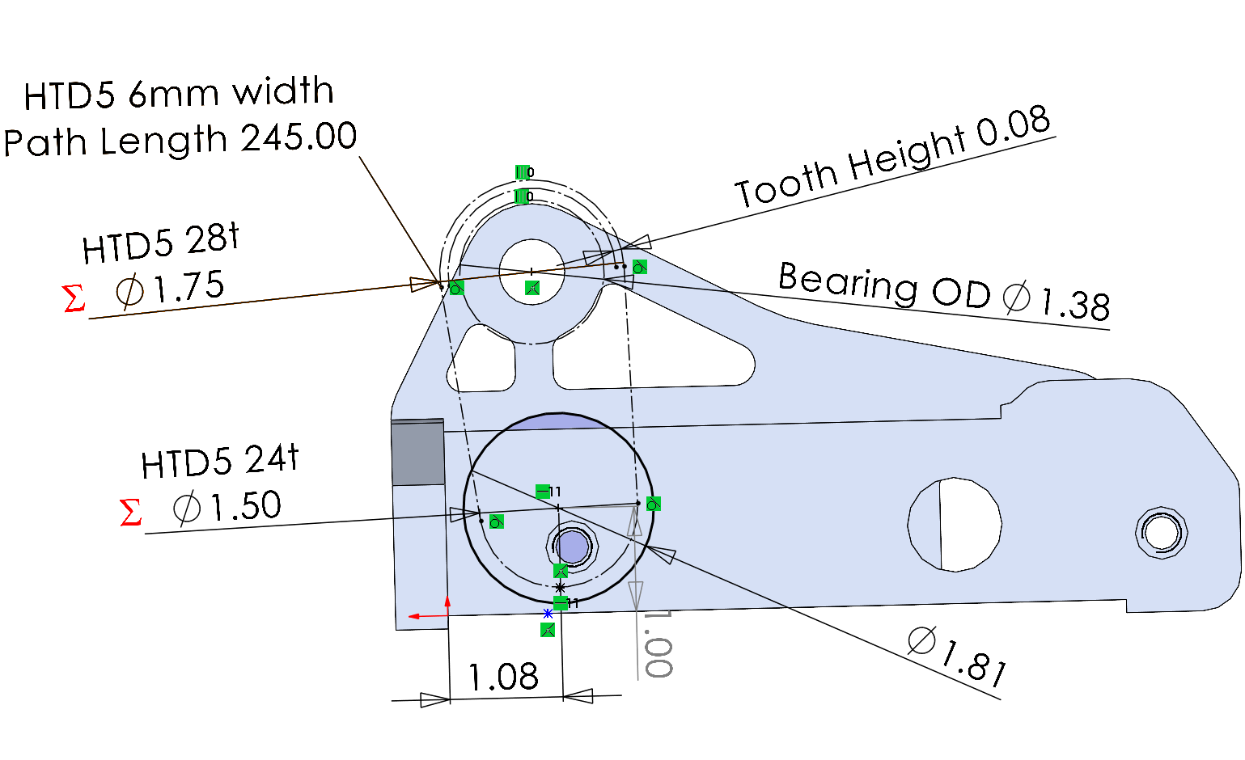
Belts
https://www.vbeltguys.com/products/245-5m-06-synchronous-timing-belt

Slide 4
Todo
Motor support plate
CAD new pullies

